Slide 1
deeeep.io
Chase Cullen

Slide 2
The game
Deeeep.io is a multiplayer game where users choose a sea creature to evolve. (Similar the first stage in the game Spore) To evolve they can either eat other players or eat the many foods in their environment. Each new creature in the progression becomes stronger.

Slide 3
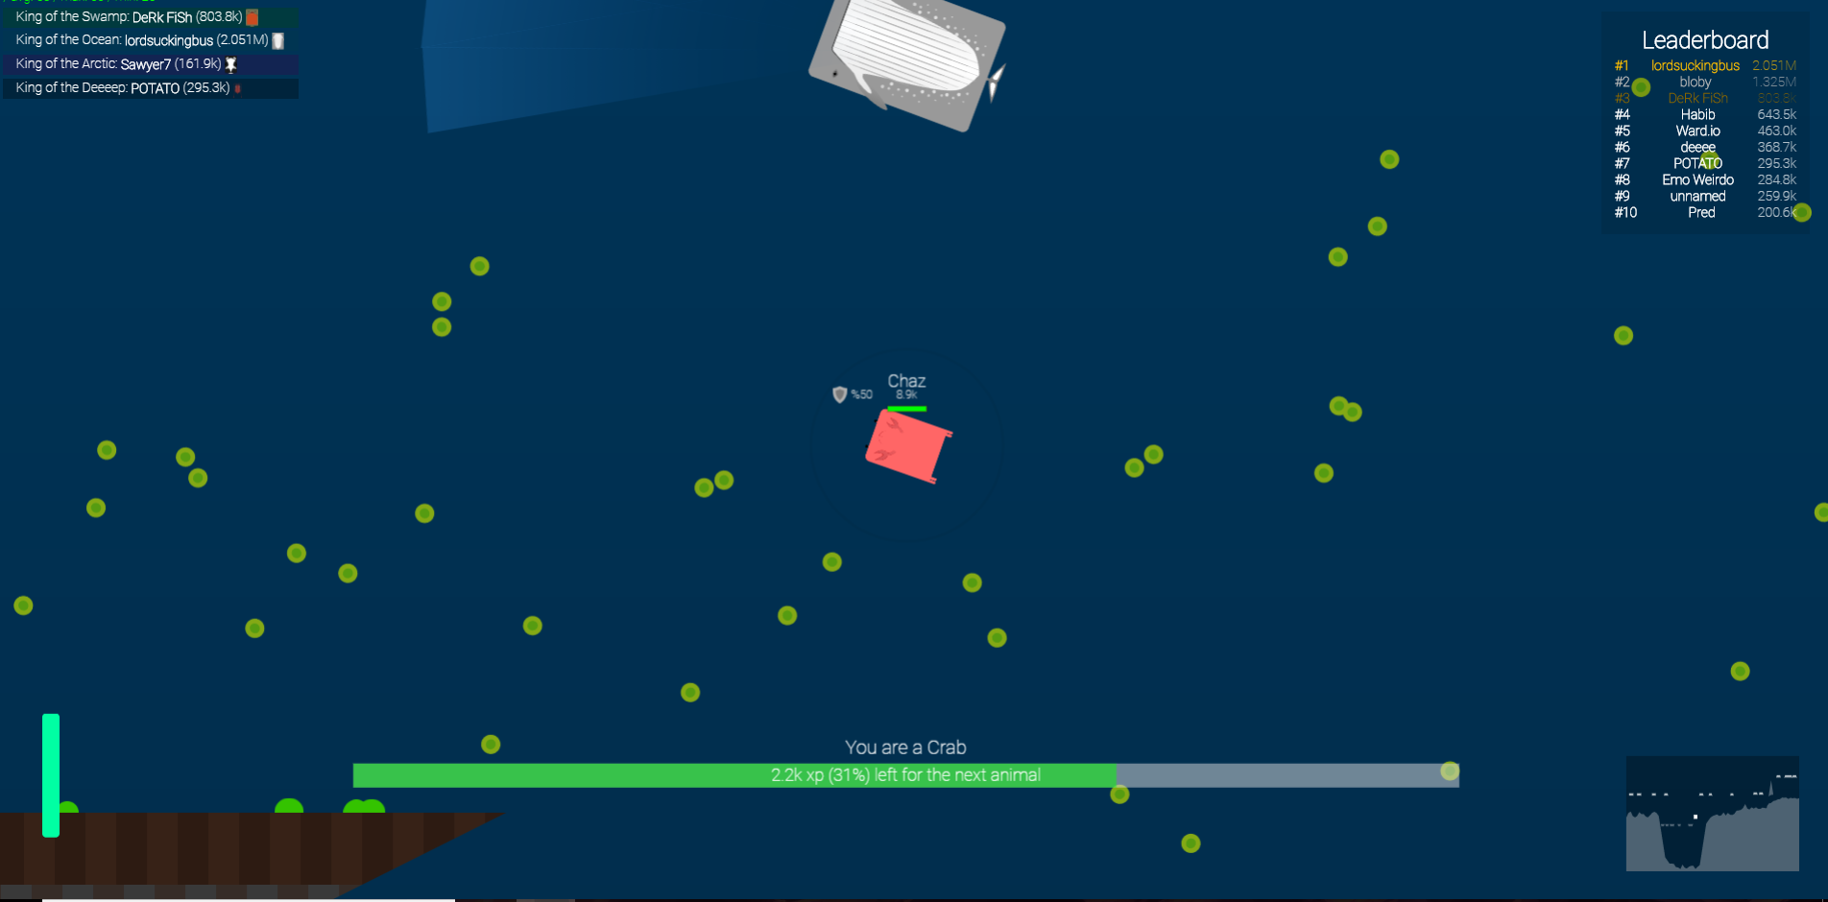

Slide 4
Proposal
-To make a game fundamentally equivalent to the deeeep.io game
-Essentially a deeeep.io rip off

Slide 5
Motivation
-Easy to play and understand
-Games are fun
-Good project to learn (multiplayer aspect)

Slide 6
App Features
-Multiplayer
-Can use touch to move or tilt device to move. Will be able to choose. My thoughts are that it will be easier for tablets to touch and smartphones to tilt, therefore I plan to include both.
-Leaderboard, saved progress, ability to change creature with progression

Slide 7
Phone Requirements
-Android or tablet
-Internet Connection
-Touch screen or Gyroscope

Slide 8
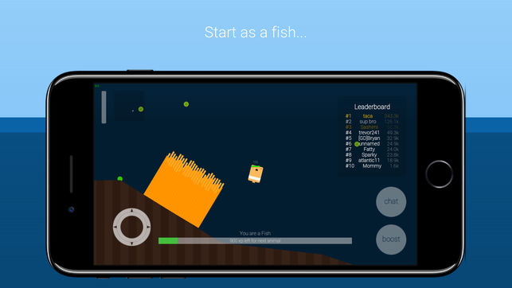
Mockups

Slide 9
Project Timeline
Week 1 (3/11 - 3/17): Research and planning, setting up basic structure
Week 2 (3/18 - 3/24): Figure out creature movement (tilt)
Week 3 (3/25 - 3/31): Figure out creature movement (touch)
Week 4 (4/1 - 4/7): Implement a map
Week 5 (4/8 - 4/14): Add models and art
Week 6 (4/15 - 4/21): Add additional features

Slide 10
Project Timeline
Week 7 (4/22 - 4/28): Add additional features
Week 8 (4/29 - 5/5): Tampering and debugging
Week 9 (5/6 - 5/12): Project Presentation

Slide 11
Anticipated Deliverables
-A functioning multiplayer game similar to deeeep.io for android

